Slide 1


Oracle Cloud ERP
Managing Purchase Requisitions

Slide 2

Welcome
This course is intended to prepare you for managing the procurement requisition process in Oracle. During this course, participants learn about:
  Creating standard requisitions
  Creating 3-way match requisitions
  Creating catalog requisitions
  Duplicate a requisition
  Editing/Canceling a requisition
  Related terminology

Slide 3

Introduction
Please briefly share the following information about yourself:
  Name
  Department and Role
  One non work-related fun fact about you
  Your familiarity with the Oracle ERP system

Slide 4





Housekeeping
Restroom and Exit locations
Help manage activities by starting and stopping on time
A 15-minute break
will be taken
approximately every 2 hours
Feel free to
ask questions
Actively listen and participate in presentations
Training schedule

Slide 5





Ground Rules
Minimize side conversations
Sign the attendance sheet
Silence cell phones and pagers
Check E-mail during breaks ONLY
Do not work on computers during instructor presentations
Provide feedback to improve training

Slide 6


Course Prerequisites
You should have completed the following courses before attending class today:
  Oracle General Overview, Navigation, and Reporting

Slide 7
Course Objectives
Upon completion of this course, you should be able to:
  Identify the benefits Oracle provides to the purchase requisition process
  Search for a requisition in Oracle
  Describe the steps needed to edit or cancel a requisition
  Explain the importance of catalogs in Oracle
  Describe the different requisitions available in Oracle used to initiate the requisition lifecycle
Notes:
Bullet Reference
Specific points of interest
Questions to ask the class
Example
Reminders for Instructor
Ask participants to introduce themselves and talk about their general experience in the xxxx area. (Include this note only in overview units - and delete this sentence)
Ask if there are any questions before you get started.
Some quick references listed may not be demonstrated in class, but are included in the Quick Reference Notebook. (Include this note only in overview units - and delete this sentence)

Slide 8
Course Modules
The course is composed of the following modules:
  Module 1: Requisition Overview
  Module 2: Managing Requisitions
  Module 3: Creating a Catalog and Non-Catalog Requisition
  Module 4: Duplicating Requisitions
  Module 5: Editing Requisitions
  Module 6: Summary

Slide 9

Course Components
Participant Guide
  Concepts
Activity Guide
  Exercises/Demonstrations
Job Aids
Course Evaluation

Slide 10

Requisition Overview
Module One

Slide 11
Learning Objectives
Upon completion of this section, you should be able to:
  Describe the benefits of the requisition process in Oracle
  Describe how purchase requisitions (PRs) are integrated with other functional areas
  Describe how a PR is created
  Explain the PR process flow
Notes:
Bullet Reference
Specific points of interest
Questions to ask the class
Example
Reminders for Instructor
Ask participants to introduce themselves and talk about their general experience in the xxxx area. (Include this note only in overview units - and delete this sentence)
Ask if there are any questions before you get started.
Some quick references listed may not be demonstrated in class, but are included in the Quick Reference Notebook. (Include this note only in overview units - and delete this sentence)

Slide 12
Benefits of Oracle
Oracle helps provide flexibility and efficiency to the procurement process, with:
Increased influence over money spent
  Enforces compliant purchasing by making it easy for employees to find what they need and direct purchases to authorized suppliers
Automated source to settle processes
  Helps standardize, streamline, and automate traditionally manual processes
Improved Supplier Management
  Receive an alert when a supplier’s qualifications are expiring or when new information becomes available that might affect supplier qualifications, capabilities, and change their risk profile

Slide 13
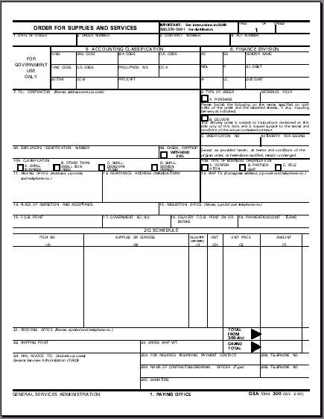
Purchase Requisitions - Integration with other areas
Sales Order
Project
Procurement
PR’s/Oracle
Sales Order:
WBS (Level 1)
Purchase Requisition
(Solicitation)
Sales Order Line 1
- Line of Accting
- BOAC
WBS (Level 2)
NWA
(Awards)
Sales Order Line 2
- Line of Accting
- BOAC
NWA
Purchase Order
NWA
Purchase Order Changes
(MODs)
Notes:
Purchase Requisitions are integrated with other areas as follows:
Material, vendor, and pricing master data is used to create the customer sales order. This same master data is populated on the purchase requisition, and is re-validated when it kicks off PO creation.
A procurement structure is set up to organize/track customer needs; requirements (PRs) are passed from the activity level of this project to Purchase Requisitions.
Purchase Requisitions are the primary component of Oracle that is used to generate solicitations to vendors. The information contained within a PR is extracted to generate the bid invitation.
Oracle is used for generating solicitations for complex task orders. The solicitation documentation can link back to a PR created from a network activity.

Slide 14
Purchase Requisition Key Points
A purchase requisition captures the basic data related to a customer’s need for goods or services
Most of the detail related to the customer need is defined in the
  Customer Order Request
  Bill of Material (BOM)
  Statement of Work (SOW)
The PR is the basis for other documents:
  Purchase order
Notes:
A customer need is known as an “external requirement.” In the project network activity, this list of external requirements is translated into a “PR” once the network activity is released.
During a regular batch run, line items from released PRs are transferred to Purchase Requisitions in the form of “requirements” for bid invitation processing.

Slide 15
Overview Requisition Process Flow
From Catalogs
Duplicate Existing
Enter Req Lines
Add Lines from Shopping Lists
Add Lines from Local Catalogs
Add Lines from Punchouts
Order Via Smart Form
Approver
Requester
Duplicate Existing Requisition
Create Non-Catalog Requests
Create Req by Entering Req Lines
Review for Approval
Notes:
A need for materials has been identified, so a purchase requisition is needed prior to a purchase order being placed. A requisition can be created using different methods, including: Creating a req from a catalog, creating a req copying an existing req, creating a non catalog req, or manually entering lines on a req. Whichever type of req that has been created, once complete, it goes to the Procurement Approver for review and approval.

Slide 16
Receiving a Requisition
Managing receipts using Oracle is a new process for Cable One requesters of Purchase Requisitions. With this process, there are specific items requesters receive/do not receive within Oracle.
Requesters are now tasked with receiving when they are given an invoice for a service or when service has been rendered:
  Non-Inventory Items (i.e., as part of a 3-way match for Suppliers to be paid by AP)
  Contract Labor receipts (authorizes an invoice to be paid by AP)
Requesters do NOT receive Inventory items at warehouse locations (includes common and project inventory). These are always received by the Warehouse Associate assigned to the receiving warehouse location
Users can only receive receipts THEY created. A user cannot receive receipts created by others

Slide 17

Knowledge Check – Question
Some benefits of using Oracle for the Procurement process includes:
Decreasing the need for oversight to manage processes
Adding extra security steps to ensure unnecessary requisitions are not created
Helps standardize, streamline, and automate manual processes
Provides the option of working around the requisition process if required

Slide 18
Knowledge Check – Answer
Some benefits of using Oracle for the Procurement process includes:
Decreasing the need for oversight to manage processes
Adding extra security steps to ensure unnecessary requisitions are not created
Helps standardize, streamline, and automate manual processes
Provides the option of working around the requisition process if required

Slide 19
Managing Requisitions
Module Two

Slide 20
Learning Objectives
Upon completion of this section, you should be able to:
  Describe the steps needed to search for a requisition in Oracle
  Explain how to create a standard requisition and understand the differences between Line Types
  Explain how to create a catalog-based requisitions
  Describe the steps needed to search for a requisition in Oracle
  Describe how update/edit a requisition
  Explain the actions needed to manage a requisition
Notes:
Bullet Reference
Specific points of interest
Questions to ask the class
Example
Reminders for Instructor
Ask participants to introduce themselves and talk about their general experience in the xxxx area. (Include this note only in overview units - and delete this sentence)
Ask if there are any questions before you get started.
Some quick references listed may not be demonstrated in class, but are included in the Quick Reference Notebook. (Include this note only in overview units - and delete this sentence)

Slide 21
Key Requisition Terms
Key Term | Definition
Entered By | Name of employee that created the requisition
Requisition | Requisition Number
Requester | Name of employee that requested the requisition
Supplier | Name of the supplier fulfilling the requisition order
Order | Purchase Order associated with the requisition
Item | Material being requisitioned and having an assigned number/name in the Oracle item master
Line Type | Describes the type of matching type. For 3-way line types, a match between PO, Receipt and Invoice is required to process the payment. For 2-way, a PO and Invoice match is required. All physical items must use 3-way match. Services will use 3-way or2-way depending on service type.

Slide 22
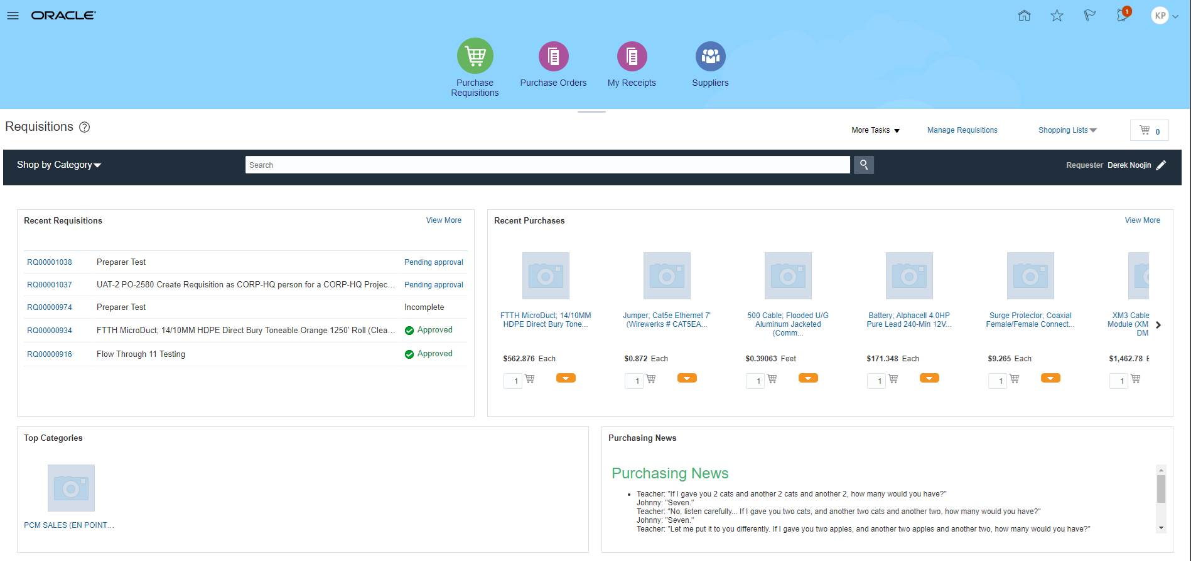
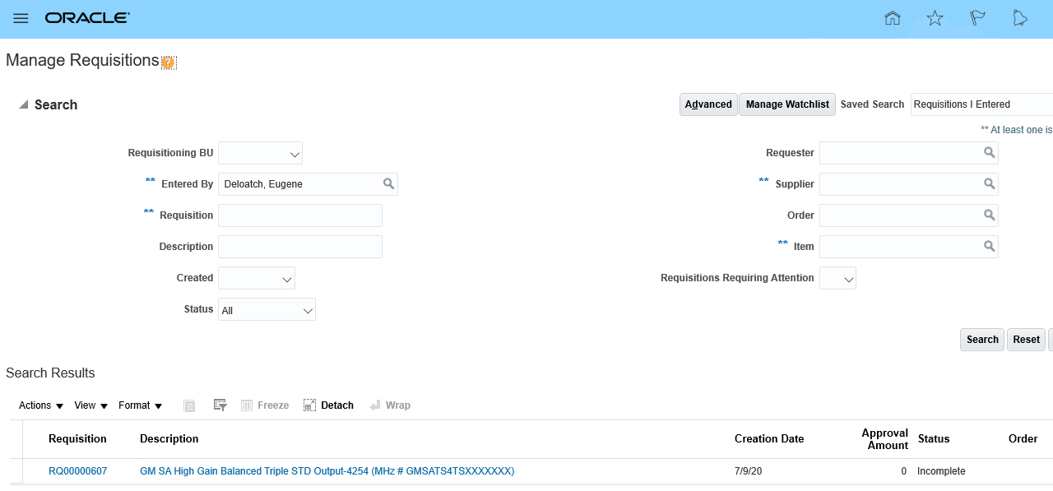
Searching for a Requisition
Start the search from the Purchase Requisitions landing page. You can access this landing page from several places, including the Springboard and the Navigator; within the “Procurement” module.
Click the Manage Requisitions link
Enter the search criteria required and click the Search button to search for the requisition

Slide 23

Demo/Exercise
Search for a Requisition
Task Demo/Exercise
Demonstration
Notes:
To perform a Demonstration/Exercise:
Direct participants to the Quick Reference Notebook and ask that they follow along as you demonstrate the task.
Turn to the appropriate quick reference in the Quick Reference Notebook and demonstrate the entire transaction on the system by following the steps in the quick reference.
If there is an exercise, after completing the demonstration, distribute copies of the Exercise to the entire class. If there is not an exercise, answer any questions about the demo and go on to the next slide.

Slide 24
Requisitioning
Oracle provides several options for the user to request goods and services and provides flexibility on how those goods and services can be ordered, received and paid for.
Creating requisition lines, one line at a time, using Enter Requisition Line
  Create requisition lines for different suppliers on the same requisition
  Create requisitions by price and quantity (Goods 3-Way, Labor 3-Way)
  Create requisitions by amount (Services 2-Way)
  Enter as many lines as needed
Creating requisitions Lines, multiple lines at a time, using Shop by Catalog
  Local Catalogs, Punchout catalogs, shopping lists, shop by category
Creating requisition lines from forms

Slide 25
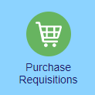

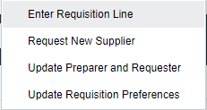
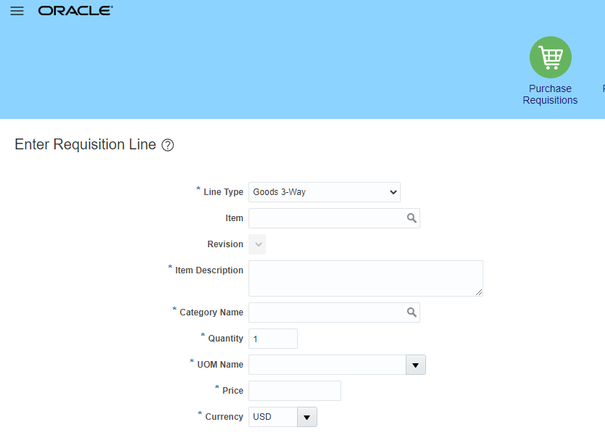

Creating Goods 3-Way Or Labor 3-Way Requisition lines
A 3-way good or services requisition is used for adding a price and a quantity to a requisition and to ensure a receipt match between the requisition quantity, purchase order quantity, and quantity invoiced:
Prior to creating one of the many requisition variations, the user selects Goods 3-Way to start the process.

Slide 26
Demo/Exercise
Create a 3-Way Inventory Item Requisition Line (15Min)
Create a 3-Way Services Requisition Line (7Min)
Task Demo/Exercise
Demonstration
Notes:
To perform a Demonstration/Exercise:
Direct participants to the Quick Reference Notebook and ask that they follow along as you demonstrate the task.
Turn to the appropriate quick reference in the Quick Reference Notebook and demonstrate the entire transaction on the system by following the steps in the quick reference.
Explain Line Type Field (show impact of switching between 3-way and 2-way)
Explain Item field (and how to get additional item info
Explain Price field
Explain the Agreement type field
Explain procedure for completing Supplier/Supplier Site
Explain the Inventory and Subinventory fields
Explain Adding to cart
Explain Review Cart (Explain reason to review and Change Requisition Description, and point to billing section briefly)
Explain the Submittal and Approval Process
If there is an exercise, after completing the demonstration, distribute copies of the Exercise to the entire class. If there is not an exercise, answer any questions about the demo and go on to the next slide.
Repeat step 2 for a Labor 3-Way

Slide 27

Creating Services 2-Way Requisition lines
A Services 2-Way requisition line type is used for basing the requisition on a dollar amount and not on a combination of quantity and price. These types of requisition line types should be limited to services or subscription type of situations.
Prior to creating the requisition, the user selects Services 2-Way to start the process.
Notes:
Line requisitions that use Services 2-Way are mean to facilitate the situations where the service being acquires does not have a know or close estimate for volume or where the price may not be know or be dependent on other variables. In this case, a line item requisition is created without a specified quantity and price per quantity. The only unit of measure is based on the amount charge to the POs.

Slide 28
Demo/Exercise
Create a Services 2-Way Requisition Line (8Min)
Task Demo/Exercise
Demonstration
Notes:
To perform a Demonstration/Exercise:
Direct participants to the Quick Reference Notebook and ask that they follow along as you demonstrate the task.
Turn to the appropriate quick reference in the Quick Reference Notebook and demonstrate the entire transaction on the system by following the steps in the quick reference.
If there is an exercise, after completing the demonstration, distribute copies of the Exercise to the entire class. If there is not an exercise, answer any questions about the demo and go on to the next slide.

Slide 29
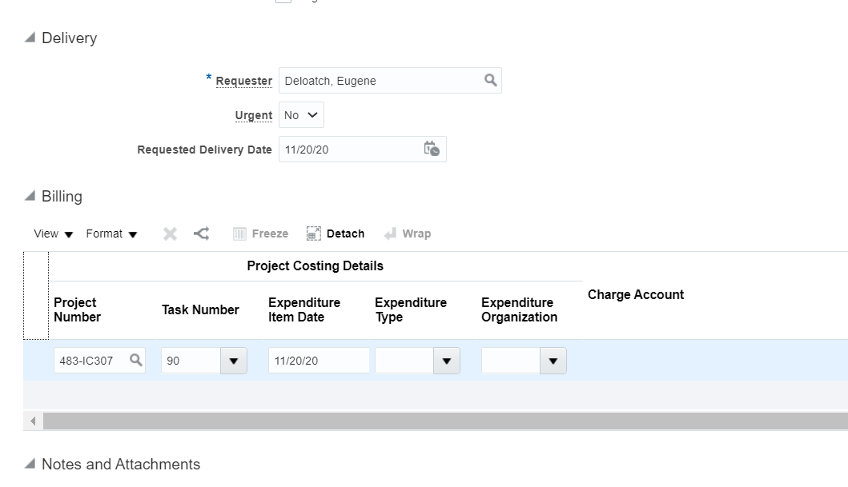

Creating Requisition Line for a Project
When creating either a 3-way or a 2-way requisition line for a project, most of the steps are identical with two exceptions.
(1) All Requisitions lines, regardless of line type, 3-Way or 2-way, require completion of Project related information.
(2) All Requisitions lines for Goods 3-Way with a part number listed in the Item field (any part number not starting with CS, IM and IS), will also require setting the Destination Type to Inventory and the SubInventory to a PRJ option)

Slide 30
Demo/Exercise
Create a 3-Way Requisition for a Project
Task Demo/Exercise
Demonstration
Notes:
To perform a Demonstration/Exercise:
Direct participants to the Quick Reference Notebook and ask that they follow along as you demonstrate the task.
Turn to the appropriate quick reference in the Quick Reference Notebook and demonstrate the entire transaction on the system by following the steps in the quick reference.
Explain Line Type Field (show impact of switching between 3-way and 2-way)
Explain Item field (and how to get additional item info
Explain Price field
Explain the Agreement type field
Explain procedure for completing Supplier/Supplier Site
Explain the Inventory and Subinventory fields (pointing towards the _PRJ Option being used for Project Items)
Explain Adding to cart
Explain Review Cart (Explain reason to review and Change Requisition Description)
Enter Project Information and explain Restrictions on date and location

Slide 31
Knowledge Check – True/False Question
Is the following statement True or False?
You can only create one line item per requisition when using the line-item process.

Slide 32
Knowledge Check – True/False Answer
You can only create one line item per requisition when using the line-item process:
False: You can enter as many line items as needed

Slide 33
Knowledge Check – True/False Question
Is the following statement True or False?
A 3-Way match is matching the Requisition quantity, Purchase Order Quantity, and the Packing Slip quantity.

Slide 34
Knowledge Check – True/False Answer
A 3-Way match is matching the Requisition quantity, Purchase Order Quantity, and the Packing Slip quantity
False: A 3-Way match is matching the Requisition quantity, Purchase Order quantity, and the quantity invoiced

Slide 35
Creating a Catalog Requisition
Module Three

Slide 36
Learning Objectives
Upon completion of this section, you should be able to:
  Describe the steps needed to create a requisition from a local, informational or Punchout Catalog
  Describe the steps needed to create a requisition from a shopping list
Notes:
Bullet Reference
Specific points of interest
Questions to ask the class
Example
Reminders for Instructor
Some quick references listed may not be demonstrated in class, but are included in the Quick Reference Notebook. (Include this note only in overview units - and delete this sentence)

Slide 37
What is a Catalog?
A catalog is a pre-created lists of items or services you can buy by searching for them or selecting them from an existing list
Cable One Catalogs are either agreement or non-agreement based:
  Agreement based catalogs are where a supplier is clearly identified on the listed item or service and the price is the latest price charged by the supplier
  Non-Agreement based catalog are where a supplier is not identified on the listed item or service and therefore the price is an estimated or unavailable price. In this case, procurement must select the supplier for you
Catalogs may be hosted (owned) by Cable One or hosted by one of our suppliers (Punchouts)
Notes:
Bullet Reference
Specific points of interest
Questions to ask the class
Example
Reminders for Instructor
Some quick references listed may not be demonstrated in class, but are included in the Quick Reference Notebook. (Include this note only in overview units - and delete this sentence)

Slide 38

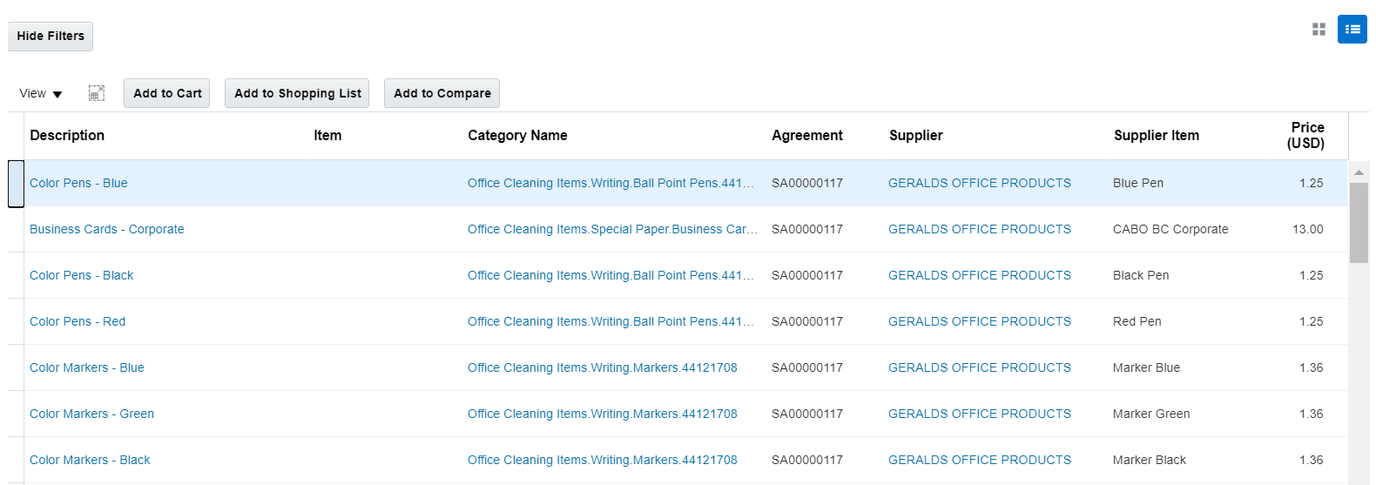
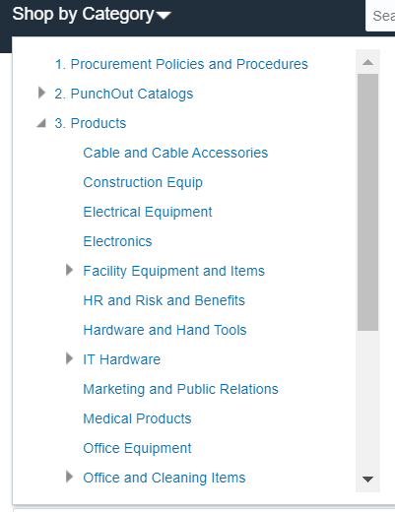
Creating a Requisition from an Internal Catalog
Once an internal catalog has been created, it is always available for searching via the search box. Other internal catalogs are also available in the shop by category. Once an item is selected, click the Add to Cart button to add the item to the shopping cart.

Slide 39
Demo/Exercise
Create a Purchase Requisition from an Internal Catalog (25min)
  Shop by Category
  Shop by Search
  Shop by Form (specified forms only)
Task Demo/Exercise
Demonstration
Notes:
To perform a Demonstration/Exercise:
Direct participants to the Quick Reference Notebook and ask that they follow along as you demonstrate the task.
Turn to the appropriate quick reference in the Quick Reference Notebook and demonstrate the entire transaction on the system by following the steps in the quick reference.
If there is an exercise, after completing the demonstration, distribute copies of the Exercise to the entire class. If there is not an exercise, answer any questions about the demo and go on to the next slide.

Slide 40
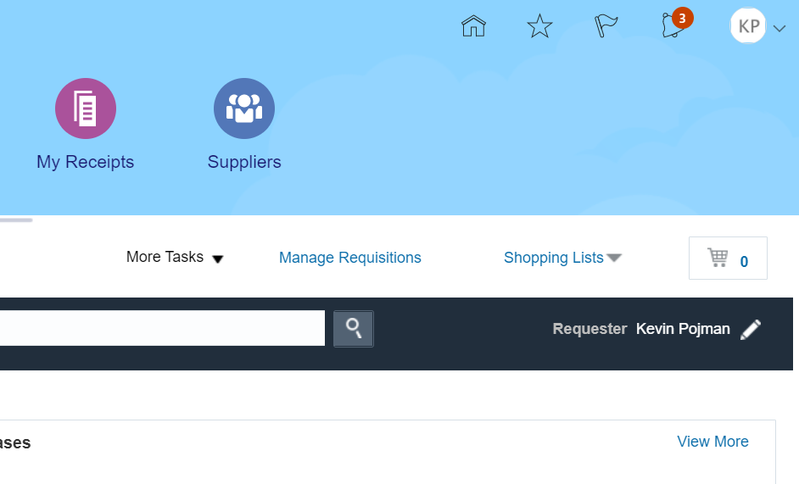
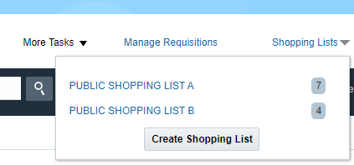
Creating a Requisition via Shopping List
Shopping lists are a collection of procurement items available to the requester for creating a requisition. You have the option of using public shopping lists or a shopping list you create and maintain yourself:
On the Requisitions Landing Page, click on the Shopping Lists drop-down arrow
Select a shopping list to begin creating a requisition

Slide 41
Demo/Exercise
Create a Requisition via Shopping List
Task Demo/Exercise
Demonstration
Notes:
To perform a Demonstration/Exercise:
Direct participants to the Quick Reference Notebook and ask that they follow along as you demonstrate the task.
Turn to the appropriate quick reference in the Quick Reference Notebook and demonstrate the entire transaction on the system by following the steps in the quick reference.
If there is an exercise, after completing the demonstration, distribute copies of the Exercise to the entire class. If there is not an exercise, answer any questions about the demo and go on to the next slide.

Slide 42
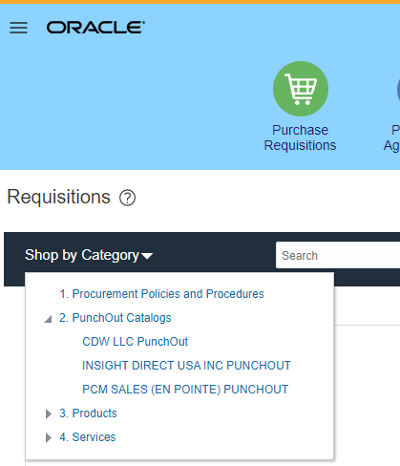
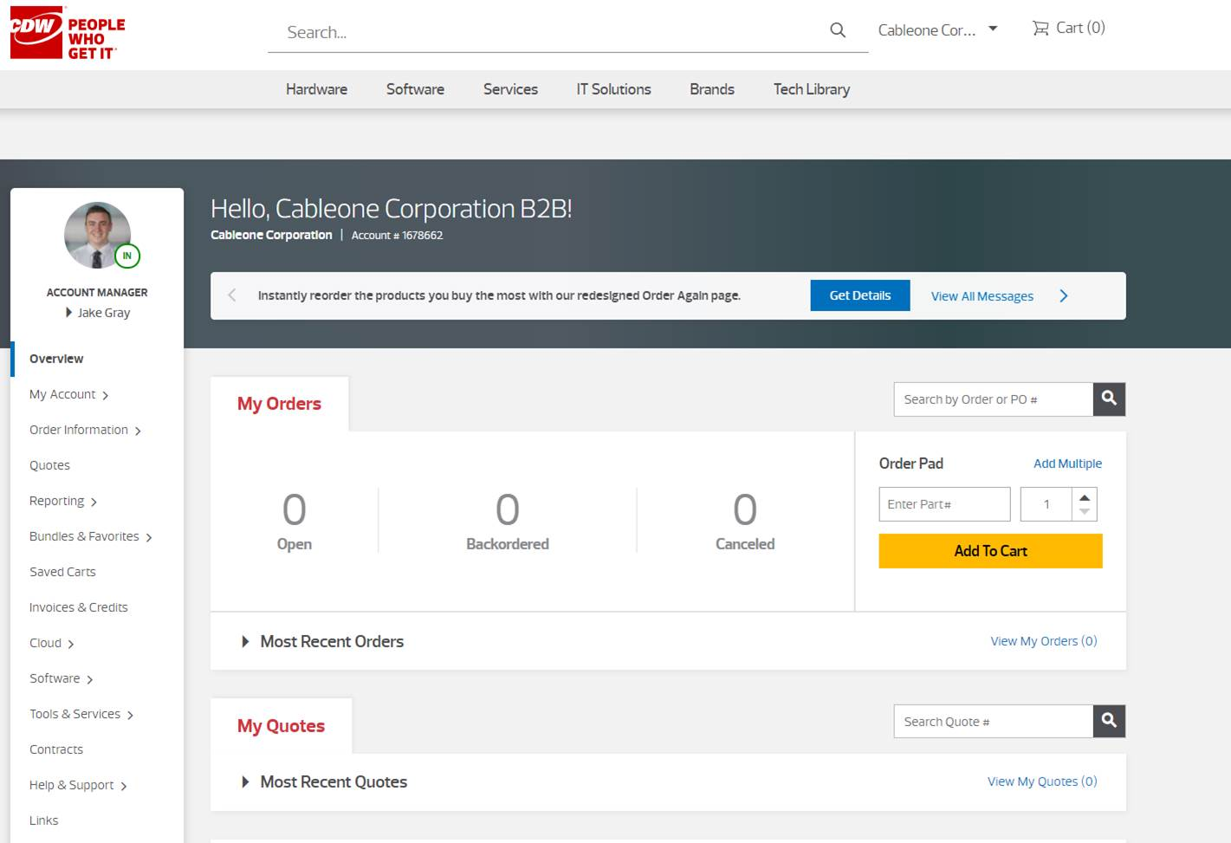
Creating a Requisition via Punchout
When creating a requisition, you may be required to order an item using a Punchout catalog. In this instance, when clicking the Shop by Category drop-down arrow, Oracle provides a link that directs you to the supplier’s site to search for the item needed:

Slide 43
Demo/Exercise
Create a Requisition via Punchout
Task Demo/Exercise
Demonstration
Notes:
To perform a Demonstration/Exercise:
Direct participants to the Quick Reference Notebook and ask that they follow along as you demonstrate the task.
Turn to the appropriate quick reference in the Quick Reference Notebook and demonstrate the entire transaction on the system by following the steps in the quick reference.
If there is an exercise, after completing the demonstration, distribute copies of the Exercise to the entire class. If there is not an exercise, answer any questions about the demo and go on to the next slide.

Slide 44
Knowledge Check – Question
After clicking Purchase Requisitions on the Oracle Home Page, what is the next item you must click to begin creating a requisition from a catalog?
Manage Requisitions
Shopping Lists
More Tasks
Catalogs

Slide 45
Knowledge Check – Answer
After clicking Purchase Requisitions on the Oracle Home Page, what is the next item you must click to begin creating a requisition from a catalog?
Manage Requisitions
Shopping Lists
More Tasks
Catalogs

Slide 46
Knowledge Check – True/False Question
Is the following statement True or False?
You can create a requisition by using either a public shopping list or a shopping list you maintain yourself.

Slide 47
Knowledge Check – True/False Answer
You can create a requisition by using either a public shopping list or a shopping list you maintain yourself
True: Oracle provides users with the option of using various shopping lists to help manage the requisition process

Slide 48
Duplicating Requisitions
Module Four

Slide 49
Learning Objectives
Upon completion of this section, you should be able to:
  Describe the steps needed to create a requisition from an existing purchase requisition
  Describe the limitations of duplicating requisitions
Notes:
Bullet Reference
Specific points of interest
Questions to ask the class
Example
Reminders for Instructor
Some quick references listed may not be demonstrated in class, but are included in the Quick Reference Notebook. (Include this note only in overview units - and delete this sentence)

Slide 50


Using Existing Purchase Requisitions
Oracle provides the option of creating a purchase requisition by utilizing an existing requisition. The benefits of this feature include:
Minimizes the risk of errors
Cuts down on entry/creation time
Flexibility to tailor the requisition as required for current needs

Slide 51
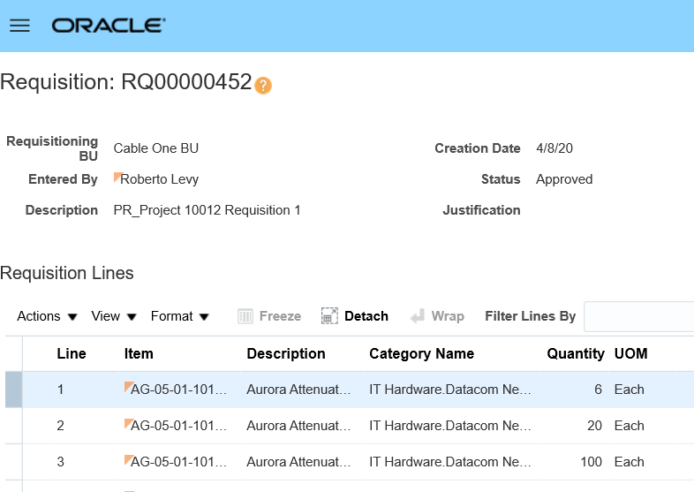
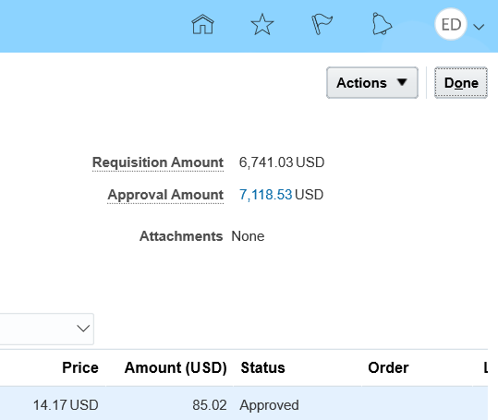
Copying a Requisition
Log in to Oracle to begin the requisition process
First, from the Requisitions Landing Page, Search and Open the Purchase Requisition you would like to duplicate
Click the Actions button and select Duplicate to continue the process

Slide 52
Demo/Exercise
Create a Duplicate Purchase Requisition from an Existing Requisition
Task Demo/Exercise
Demonstration
Notes:
To perform a Demonstration/Exercise:
Direct participants to the Quick Reference Notebook and ask that they follow along as you demonstrate the task.
Turn to the appropriate quick reference in the Quick Reference Notebook and demonstrate the entire transaction on the system by following the steps in the quick reference.
If there is an exercise, after completing the demonstration, distribute copies of the Exercise to the entire class. If there is not an exercise, answer any questions about the demo and go on to the next slide.

Slide 53
Knowledge Check – True/False Question
Is the following statement True or False?
Oracle does not allow you to make changes to a purchase requisition created by copying an existing requisition.

Slide 54
Knowledge Check – True/False Answer
Oracle does not allow you to make changes to a purchase requisition created by copying an existing requisition
False: Oracle provides users the option of making changes to a duplicate purchase requisition as needed

Slide 55
Editing Requisitions
Module Five

Slide 56
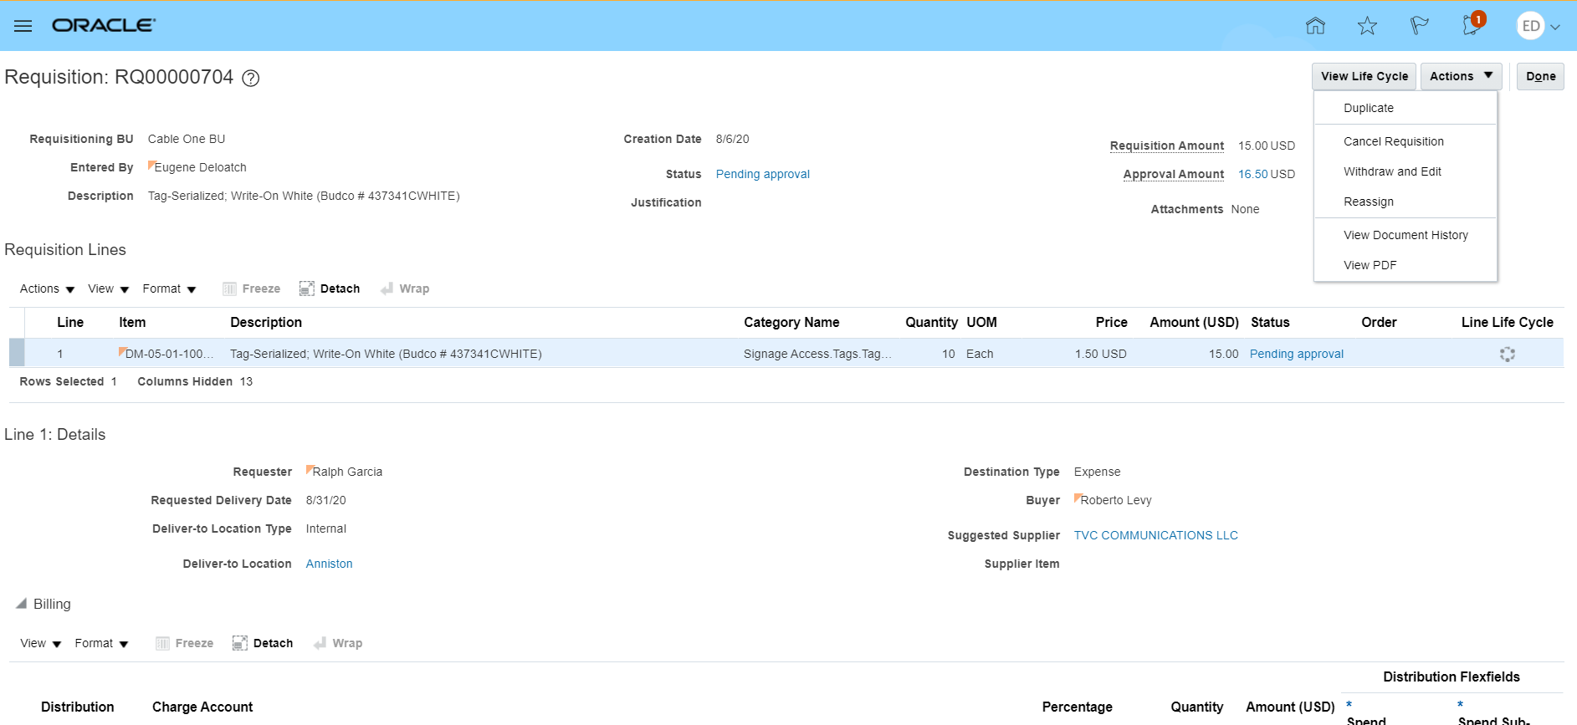
Editing a Requisition
Oracle provides the option of editing a requisition prior to a purchase order being created (as well as after it has been approved). You can access the requisition you need to edit and select Withdraw and Edit from the Actions menu. The steps for editing depends on whether it is still in a pending or approved status and whether a purchase order has been created:

Slide 57
Demo/Exercise
Edit a Requisition (45min)
  Edit Requisition in Incomplete Status
  Edit Requisition in Approved Status (where PO has not been created)
  Edit Requisition in Approved Status (where PO has been created)
Task Demo/Exercise
Demonstration
Notes:
To perform a Demonstration/Exercise:
Direct participants to the Quick Reference Notebook and ask that they follow along as you demonstrate the task.
Turn to the appropriate quick reference in the Quick Reference Notebook and demonstrate the entire transaction on the system by following the steps in the quick reference.
If there is an exercise, after completing the demonstration, distribute copies of the Exercise to the entire class. If there is not an exercise, answer any questions about the demo and go on to the next slide.

Slide 58
Cancel a Requisition
Canceling a requisition is allowed if an accompanying purchase order has not been created:
Click the Manage Requisitions link
(Search and) Select the requisition to be canceled
Click the Actions drop-down arrow
Select Cancel Requisition

Slide 59
Demo/Exercise
Cancel a Requisition
Task Demo/Exercise
Demonstration
Notes:
To perform a Demonstration/Exercise:
Direct participants to the Quick Reference Notebook and ask that they follow along as you demonstrate the task.
Turn to the appropriate quick reference in the Quick Reference Notebook and demonstrate the entire transaction on the system by following the steps in the quick reference.
If there is an exercise, after completing the demonstration, distribute copies of the Exercise to the entire class. If there is not an exercise, answer any questions about the demo and go on to the next slide.

Slide 60
Knowledge Check – True/False Question
Is the following statement True or False?
You can only edit a requisition if it has not reached an approved status.

Slide 61
Knowledge Check – True/False Answer
You can only edit a requisition if it has not reached an approved status.
False: You can still edit a requisition with permission even after it has been approved.

Slide 62
Course Summary
Module Six

Slide 63
Course Summary
Having completed this course, you should be able to:
  Identify the benefits Oracle provides to the purchase requisition process
  Search for a requisition in Oracle
  Describe the steps needed to edit or cancel a requisition
  Explain the importance of catalogs in Oracle
  Describe the different requisitions available in Oracle used to initiate the requisition lifecycle

Slide 64

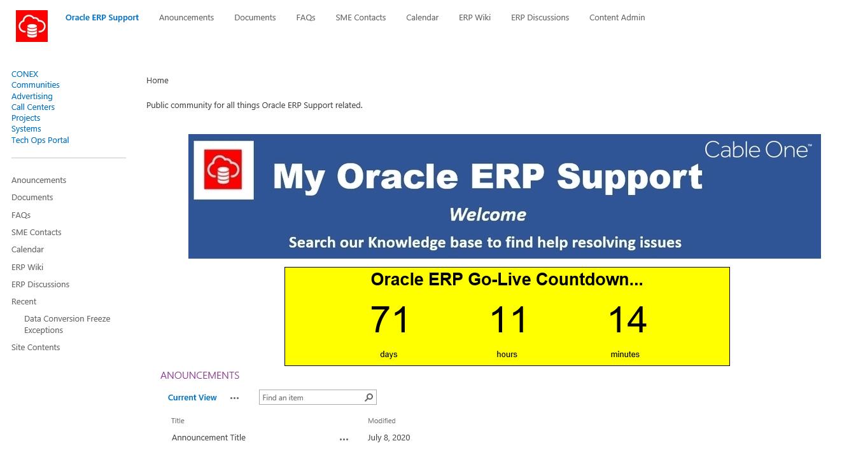
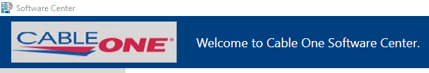
Additional Help Resources
My Technology Services (MyTS )
  Ticketing system to report Oracle related issues
  https://myts.corp.cableone.net/ux/myitapp/#/catalog/home
ERP Support Portal
  Knowledge base to find help resolving Oracle related issues
  Access to job aids, work instructions and training materials
  http://conex/communities/erpsupport/default.aspx
Cable One Software Center
  Google Chrome is the preferred browser

Slide 65

Course Evaluation
Your responses provide the Cable One Training Team with feedback that is used to continuously improve the training program
Instructor will provide access to the class evaluation

Slide 66

Congratulations
You have completed the Oracle Cloud ERP Managing Purchase Requisitions Course

Slide 67
Thank You

